Slide 1
Classification
Part 1
CME4416 – Introduction to Data Mining

Slide 2

Outline
What Is Classification?
Classification Examples
Classification Methods
  Decision Trees
  Bayesian Classification
  K-Nearest Neighbor
  Neural Network
  Support Vector Machines (SVM)
  Fuzzy Set Approaches

Slide 3
Supervised vs. Unsupervised Learning
Supervised learning (classification)
  Supervision: The training data (observations, measurements, etc.) are accompanied by labels indicating the class of the observations
  New data is classified based on the training set
Unsupervised learning (clustering)
  The class labels of training data is unknown
  Given a set of measurements, observations, etc. with the aim of establishing the existence of classes or clusters in the data

Slide 4
Prediction Problems: Classification vs. Numeric Prediction
Classification
  predicts categorical class labels (discrete or nominal)
  classifies data (constructs a model) based on the training set and the values (class labels) in a classifying attribute and uses it in classifying new data
Numeric Prediction
  models continuous-valued functions
Typical applications
  Credit/loan approval:
  Medical diagnosis: if a tumor is cancerous or benign
  Fraud detection: if a transaction is fraudulent
  Web page categorization: which category it is

Slide 5
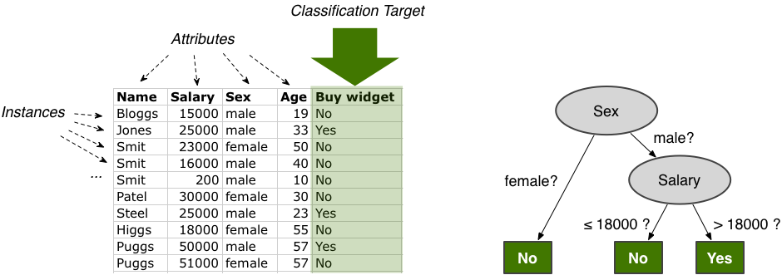
What Is Classification?
Classification
  Construction of a model to classify data
  When constructing the model, use the training set and the class labels (i.e. yes no) in the target column
  Training Set
  Model

Slide 6
Classification Steps
Model construction
  Each tuple is assumed to belong to a predefined class
  The set of tuples used for model construction is training set
  The model is represented as classification rules, trees, or mathematical formulae
Test Model
  Using test set, estimate accuracy rate of the model
    Accuracy rate is the percentage of test set samples that are correctly classified by the model
Model Usage (Classifying future or unknown objects)
  If the accuracy is acceptable, use the model to classify data tuples whose classes don’t known

Slide 7
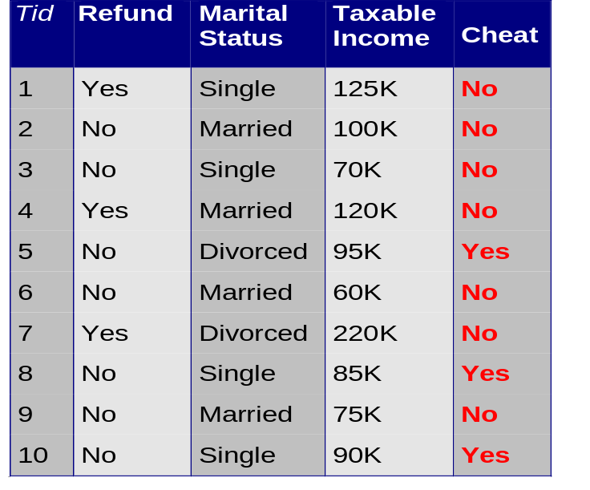
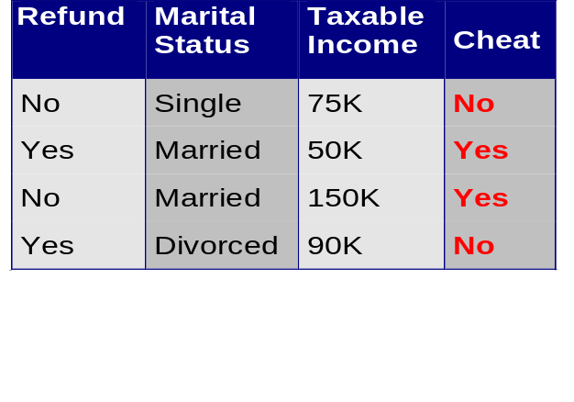
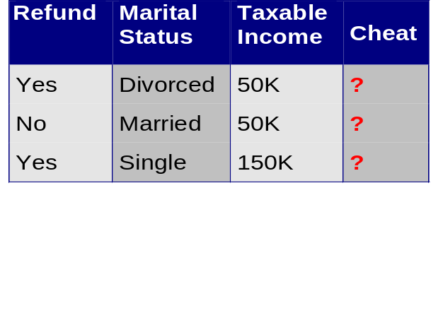
Classification Steps
2. Test Model
Test
Set
1. Construct Model
Learn
Classifier
Training
Set
Model
New
Data
3. Use Model

Slide 8
Classification (A Two-Step Process)
Data
To Predict
Training Data
Test Data
Mining Model
Mining Model
DM
Engine
DM
Engine
Mining Model
Predicted Data
Accuracy Rate
of the Model

Slide 9

Classification Example
Given old data about customers and payments, predict new applicant’s loan eligibility.
  Good Customers
  Bad Customers
Previous customers
Classifier
Rules
Age
Salary
Profession
Location
Customer type
Salary > 5 L
Good/
bad
Prof. = Exec
New applicant’s data

Slide 10
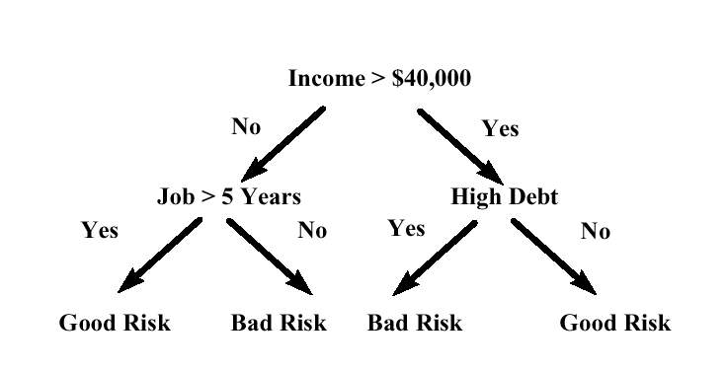
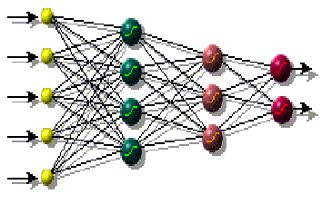
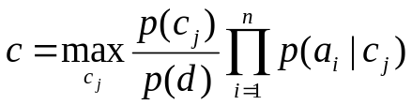
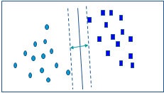
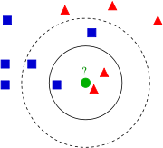

Classification Techniques
Decision Trees
Bayesian Classification
K-Nearest Neighbor
4. Neural Network
Support Vector Machines (SVM)
Fuzzy Set Approaches

Slide 11
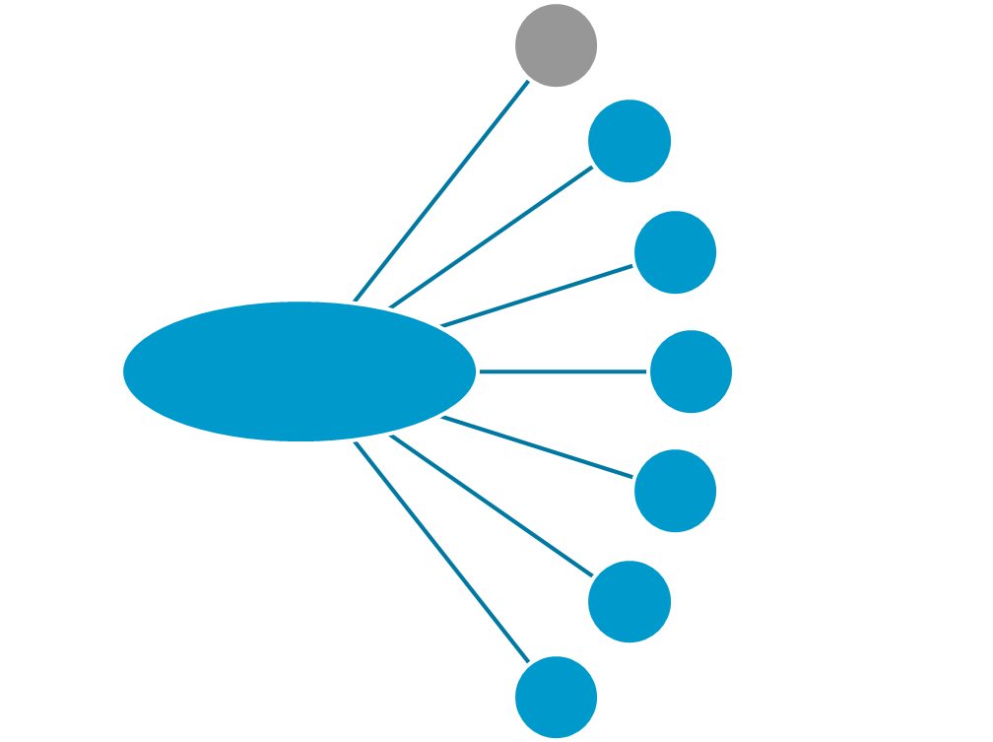
Classification Techniques
Decision Trees
Bayesian Classification
K-Nearest Neighbor
Classification
Neural Network
Support Vector Machines (SVM)
Fuzzy Set Approaches
…

Slide 12
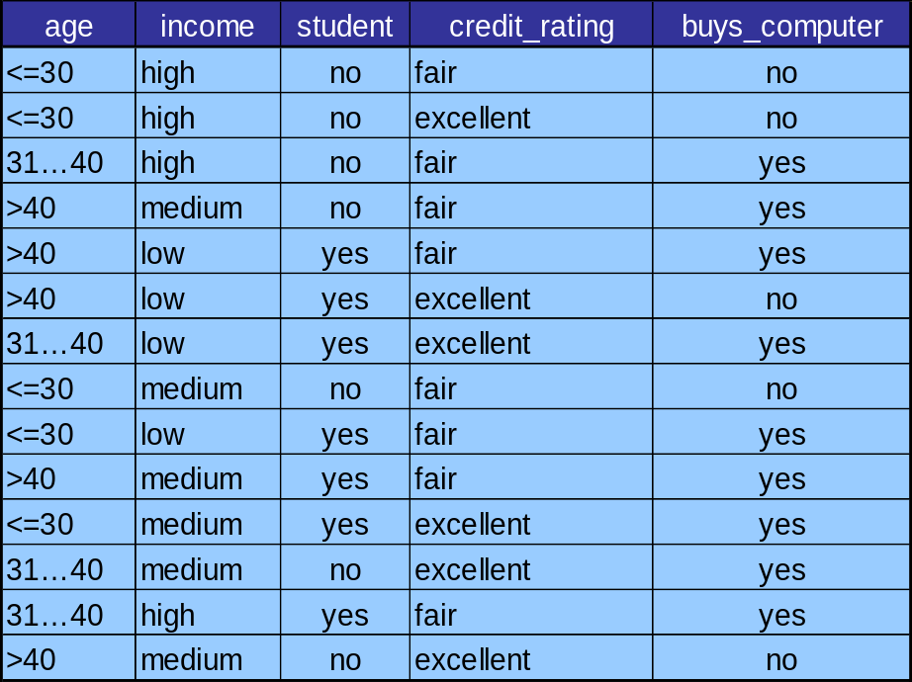
Decision Trees
Decision Tree is a tree where
  internal nodes are simple decision rules on one or more attributes
  leaf nodes are predicted class labels
Decision trees are used for deciding between several courses of action
Attribute
Value
age?
<=30
>40
31..40
Classification
student?
yes
credit rating?
No
Yes
Excellent
Fair
no
yes
no
yes

Slide 13
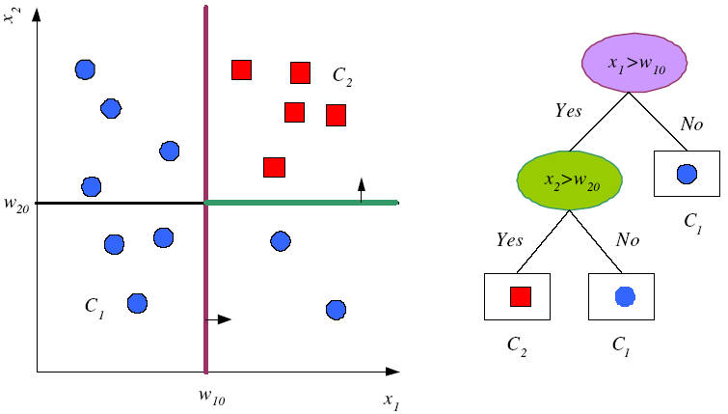
Decision Regions

Slide 14
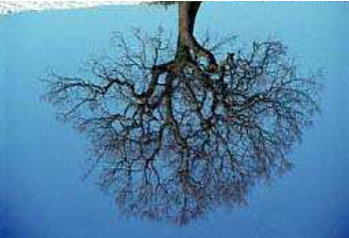
Desicion Tree Applications
Decision trees are used extensively in data mining.
Has been applied to:
  classify medical patients based on the disease,
  classify customers based on past behavior (their interests, loyalty, etc.),
  classify documents
  ...
Salary < 1 M
Job = teacher
Age < 30
Good
Bad
Bad
Good
House Hiring

Slide 15
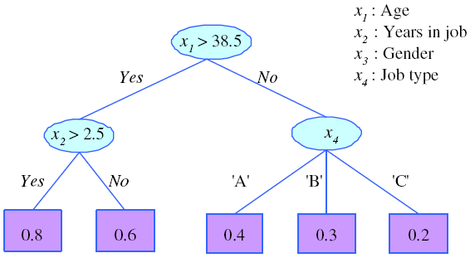
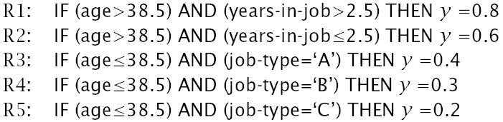
Rules Indicated by Decision Trees
Write a rule for each path in the decision tree from the root to a leaf.

Slide 16
Decision Tree Algorithms
ID3
  Quinlan (1981)
  Tries to reduce expected number of comparison
C 4.5
  Quinlan (1993)
  It is an extension of ID3
  Just starting to be used in data mining applications
  Also used for rule induction
CART
  Breiman, Friedman, Olshen, and Stone (1984)
  Classification and Regression Trees
CHAID
  Kass (1980)
  Oldest decision tree algorithm
  Well established in database marketing industry
QUEST
  Loh and Shih (1997)

Slide 17
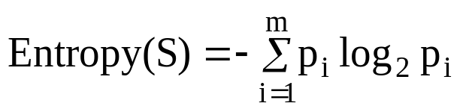
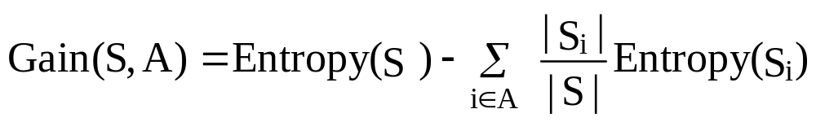
Decision Tree Construction
Which attribute is the best classifier?
  Calculate the information gain G(S,A) for each attribute A.
  Select the attribute with the highest information gain.
  An easy way to understand the entropy of a set is to think in terms of the uncertainty associated with guessing the result if you were to make a random selection from the set.

Slide 18
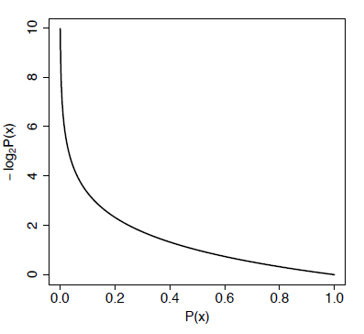
Entropy
Entropy is related to the probability of a outcome.
High probability -> Low entropy
Low probability -> High entropy
If we take the log of a probability and multiply it by -1 we get this mapping!

Slide 19
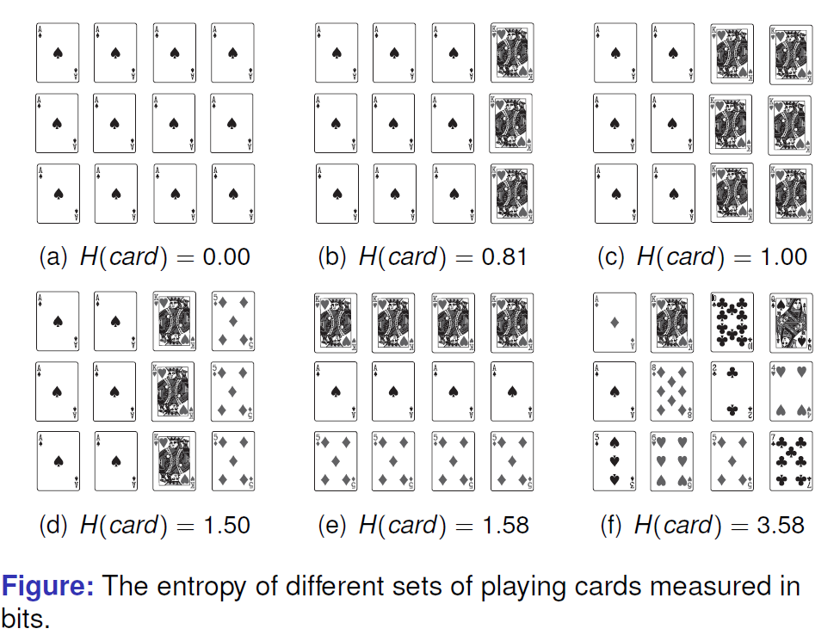
Shannon’s Entropy

Slide 20
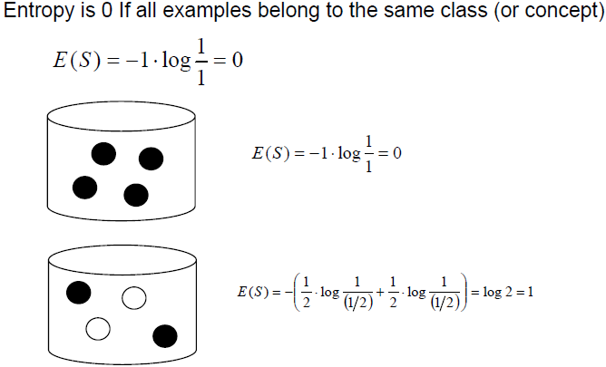
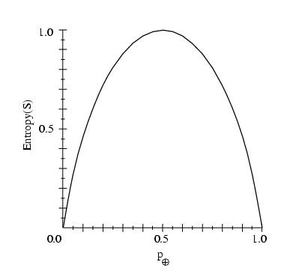
Entropy

Slide 21
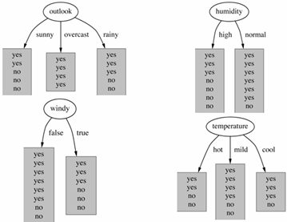
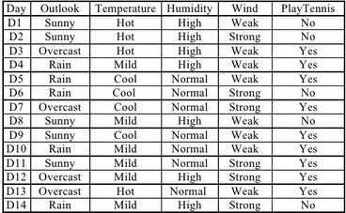
Decision Tree Construction
Which attribute first?

Slide 22
Decision Tree Construction

Slide 23

Decision Tree Construction
Day Wind Tennis?
D1 weak no
D2 strong no
D3 weak yes
D4 weak yes
D5 weak yes
D6 strong no
D7 strong yes
D8 weak no
D9 weak yes
D10 weak yes
D11 strong yes
D12 strong yes
D13 weak yes
D14 strong no
Values(wind)=weak, strong
S = [9+, 5-]
S_{weak} = [6+, 2-]
S_{strong} = [3+, 3-]

Slide 24
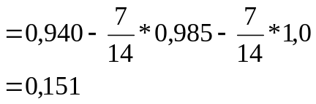
Decision Tree Construction
Outlook
sunny
overcast rain
[2+, 3-]
[4+, 0]
[3+, 2-]
E=0.971
E=0.0
E=0.971
Gain(S,Outlook)=0.940-(5/14)*0.971
-(4/14)*0.0
- (5/14)*0.0971
=0.247

Slide 25
Decision Tree Construction
Gain(S, Outlook) = 0,246
Gain(S, Temperature) = 0,029
Gain(S, Humidity) = 0,151
Gain(S, Wind) = 0,048
Outlook
Sunny
rain
overcast
?
?
yes

Slide 26
Decision Tree Construction
Which attribute is next?
Outlook
Sunny
rain
overcast
?
?
yes

Slide 27
Decision Tree Construction
Outlook
rain
Sunny
overcast
Humidity
Wind
yes
[D3,D7,D12,D13]
High
Normal
weak
strong
No
yes
yes
no
[D4,D5,D10]
[D6,D14]
[D1,D2, D8]
[D9,D11]

Slide 28
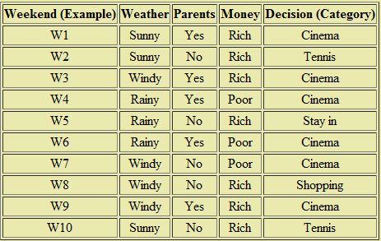

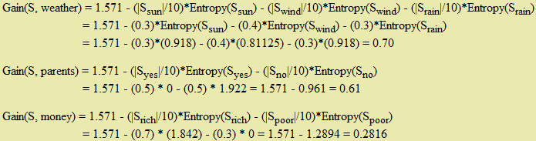

Another Example
At the weekend:
- go shopping,
- watch a movie,
- play tennis or
- just stay in.
What you do depends on three things:
the weather (windy, rainy or sunny);
how much money you have (rich or poor) - whether your parents are visiting.

Slide 29
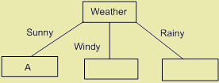
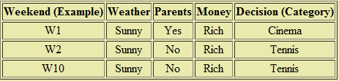
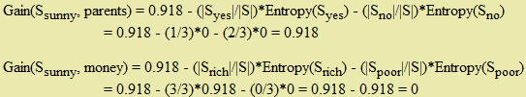
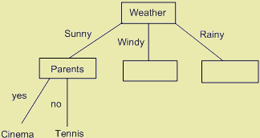
Another Example

Slide 30
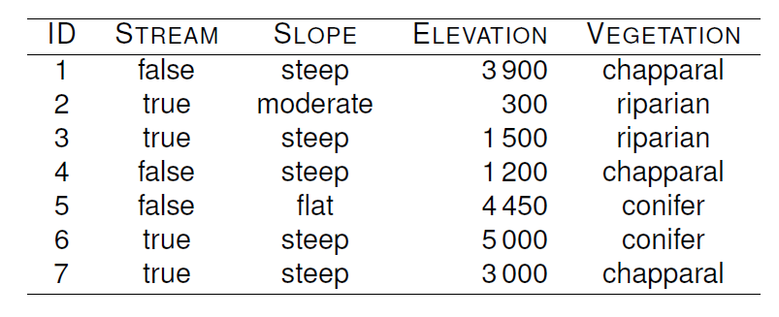
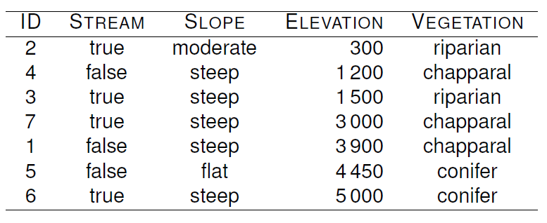
Continuous features? Example
<= Dataset
Dataset sorted by continuous feature ‘Elevation’ =>

Slide 31
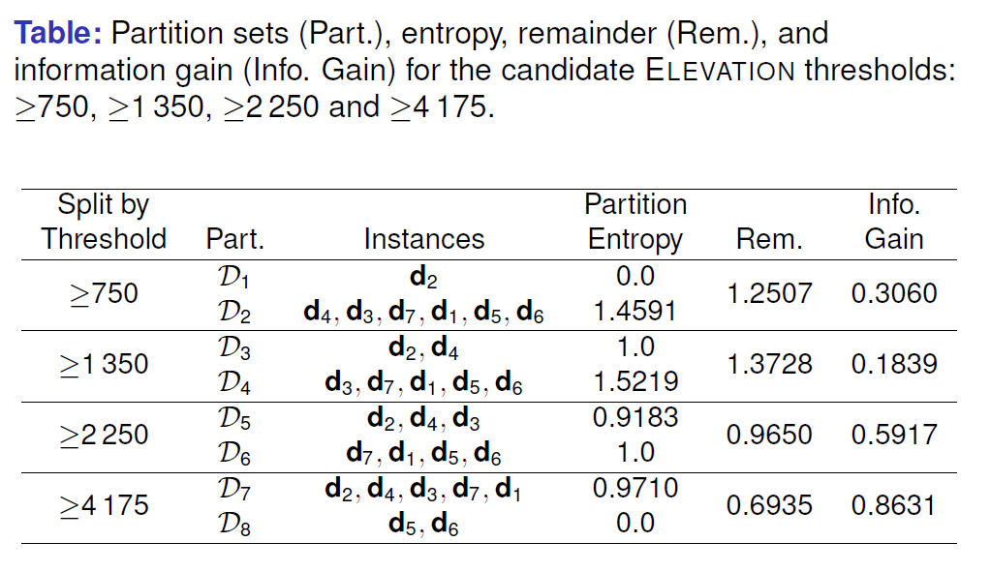

Slide 32
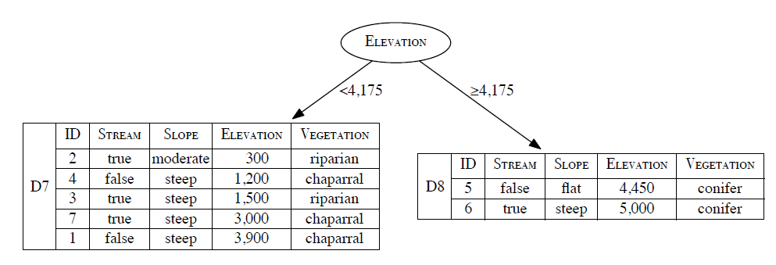

Slide 33
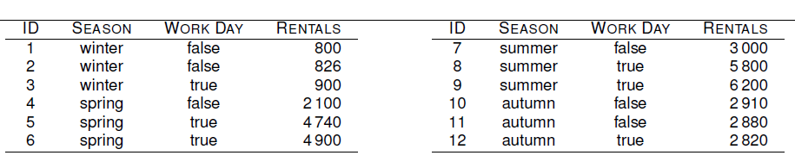
Continuous Target?
Regression trees are constructed so as to reduce the variance in the set of training examples at each of the leaf nodes in the tree.

Slide 34
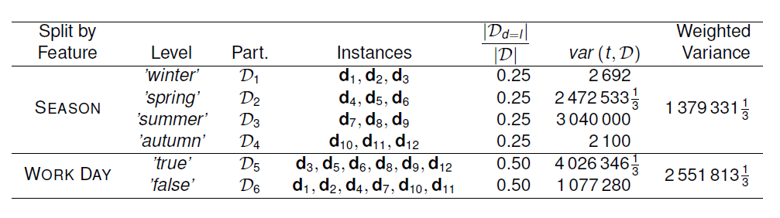
Use a measure of variance rather than a measure of classification impurity (entropy) when selecting the best attribute.

Slide 35
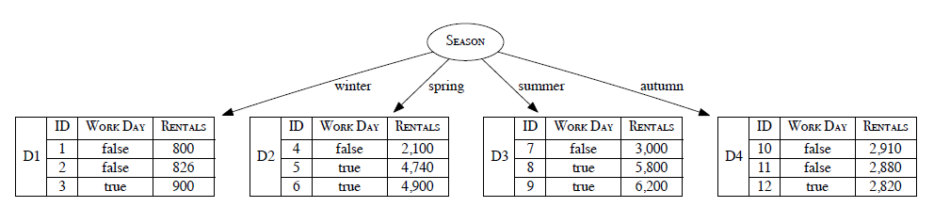

Slide 36
Overfitting and Tree Pruning
Overfitting: An induced tree may overfit the training data
  Too many branches, some may reflect anomalies due to noise or outliers
  Poor accuracy for unseen samples
Two approaches to avoid overfitting
  Prepruning: Halt tree construction early ̵ do not split a node if this would result in the goodness measure falling below a threshold
    Difficult to choose an appropriate threshold
  Postpruning: Remove branches from a “fully grown” tree—get a sequence of progressively pruned trees
    Use a set of data different from the training data to decide which is the “best pruned tree”

Slide 37
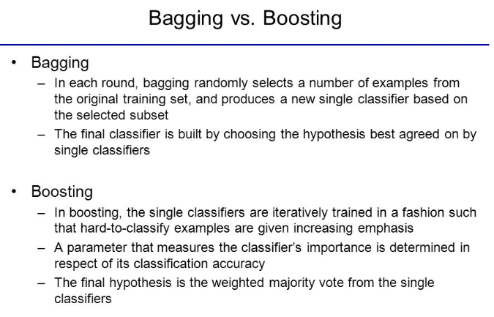
Model Ensembles

Slide 38
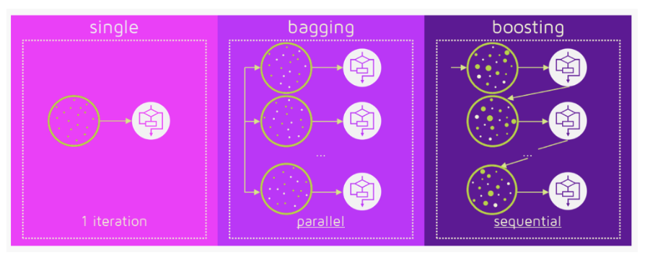
In the case of Bagging, any element has the same probability to appear in a new data set. However, for Boosting the observations are weighted and therefore some of them will take part in the new sets more often:
Figure: https://medium.com/mlreview/gradient-boosting-from-scratch-1e317ae4587d

Slide 39
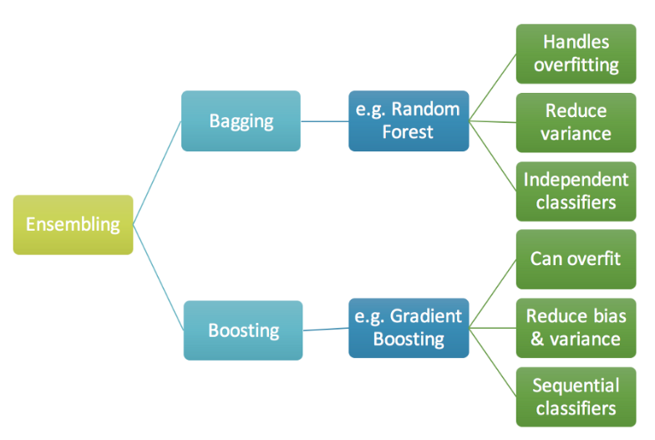

Figure: https://medium.com/mlreview/gradient-boosting-from-scratch-1e317ae4587d

Slide 40
Most slides are acknowledged from:
Assoc. Prof. Dr. Derya Birant

